Slide 1
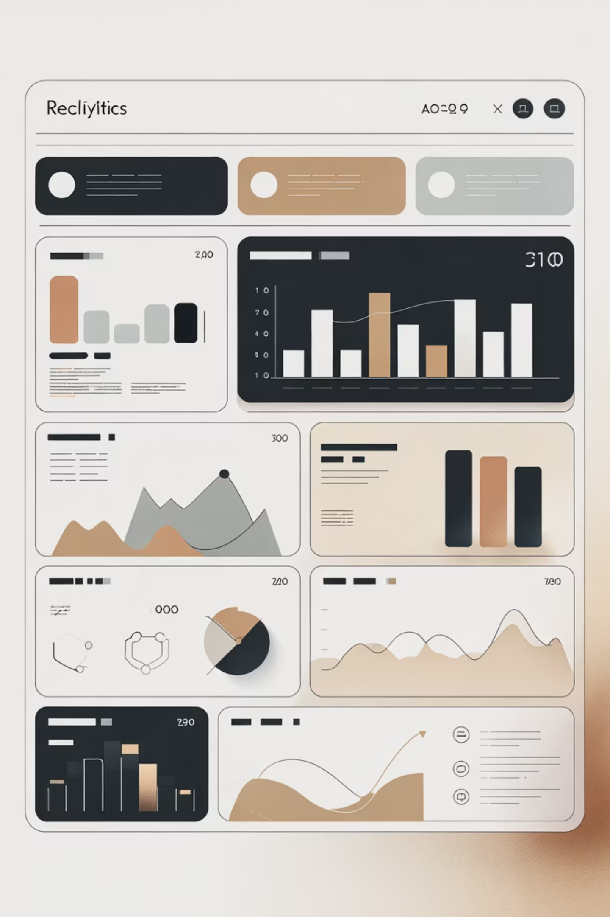
Customer Shopping Behavior Analysis
Analyzing 3,900 purchases to uncover insights into spending patterns, customer segments, and product preferences that drive strategic business decisions.

Slide 2
Dataset Overview
3,900
18
25
50
Total Purchases
Data Columns
Product Types
Locations
Transactions analyzed across all categories
Features covering demographics and behavior
Diverse items across four categories
Geographic distribution of customers
Customer Data
Transaction Details
Age, Gender, Location
Product, Category, Amount
Subscription Status
Season, Size, Color
Purchase History
Discounts & Shipping

Slide 3
Data Preparation Process
01
02
03
Data Loading & Exploration
Missing Data Handling
Feature Engineering
Imported dataset using pandas, examined structure with df.info() and summary statistics
Imputed 37 missing Review Rating values using median rating per product category
Created age_group bins and purchase_frequency_days columns for deeper analysis
04
05
Data Consistency
Database Integration
Standardized columns to snake_case, removed redundant promo_code_used field
Connected to PostgreSQL and loaded cleaned data for SQL-based business analysis

Slide 4

Key Statistical Insights
Customer Profile
Purchase Behavior
Engagement
Avg Previous: 25 purchases
Average Age: 44 years
Avg Amount: $59.76
Subscribers: 27%
Age Range: 18-70
Range: $20-$100
Discount Use: 43%
Gender Split: 68% Male, 32% Female
Avg Rating: 3.75/5.0

Slide 5

Revenue Analysis by Gender
Male Customers
$157,890 total revenue
68% of customer base driving 68% of total revenue
Female Customers
$75,191 total revenue
32% of customer base contributing 32% of revenue
Revenue distribution aligns proportionally with customer demographics, suggesting consistent spending patterns across genders.

Slide 6



Customer Segmentation Insights
80%
18%
2%
Loyal Customers
Returning Buyers
New Customers
3,116 customers with 5+ purchases
701 customers with 2-4 purchases
83 first-time purchasers
Subscription Behavior
Strategic Opportunity
Among repeat buyers (5+ purchases): 958 are subscribers while 2,518 are not, indicating significant opportunity for subscription conversion.
Large loyal customer base without subscriptions represents untapped recurring revenue potential.

Slide 7
Product Performance Analysis
1
2
3
Gloves
Sandals
Boots
Highest rated at 3.86 average
Strong performance at 3.84
Solid rating of 3.82
4
5
Hat
Skirt
Consistent at 3.80 rating
Reliable at 3.78 rating
Top Products by Category
Accessories: Jewelry (171 orders), Sunglasses (161), Belt (161)
Clothing: Blouse (171), Pants (171), Shirt (169)
Footwear: Sandals (160), Shoes (150), Sneakers (145)
Outerwear: Jacket (163), Coat (161)

Slide 8

Discount Strategy Effectiveness
High-Value Discount Users
839 customers used discounts but still spent above the $59.76 average, demonstrating that promotions can drive premium purchases without sacrificing revenue.
Discount-Dependent Products
Hat (50% discount rate)
Sneakers (49.66%)
Coat (49.07%)
Sweater (48.17%)
Pants (47.37%)
These products rely heavily on discounts for sales, requiring careful margin management and strategic promotion timing.

Slide 9


Shipping & Subscription Patterns
Express Shipping
Standard Shipping
$60.48 average purchase
$58.46 average purchase
Premium shipping correlates with slightly higher spending
Most common choice with consistent spending
Subscription Impact Analysis
Subscribers (1,053 customers):
Non-Subscribers (2,847 customers):
Average spend: $59.49
Average spend: $59.87
Total revenue: $62,645
Total revenue: $170,436
Similar spending patterns suggest subscription benefits need stronger differentiation to drive conversion.

Slide 10
Strategic Recommendations
Boost Subscription Value
Implement Loyalty Programs
Optimize Discount Strategy
Promote exclusive benefits and perks to convert the 2,518 loyal non-subscribers into recurring revenue streams.
Reward repeat buyers to accelerate movement from "Returning" to "Loyal" segments, strengthening customer lifetime value.
Balance promotional sales boosts with margin control, especially for discount-dependent products like hats and sneakers.
Leverage Top Performers
Target High-Value Segments
Highlight top-rated products (Gloves, Sandals, Boots) and best-sellers (Jewelry, Blouses) in marketing campaigns.
Focus marketing on Young Adults ($62,143 revenue), express shipping users, and high-spending discount customers.

